Slide 1

Data Bootcamp Final Project Presentation
MARKETING CAMPAIGN
Nse Assangha

Slide 2
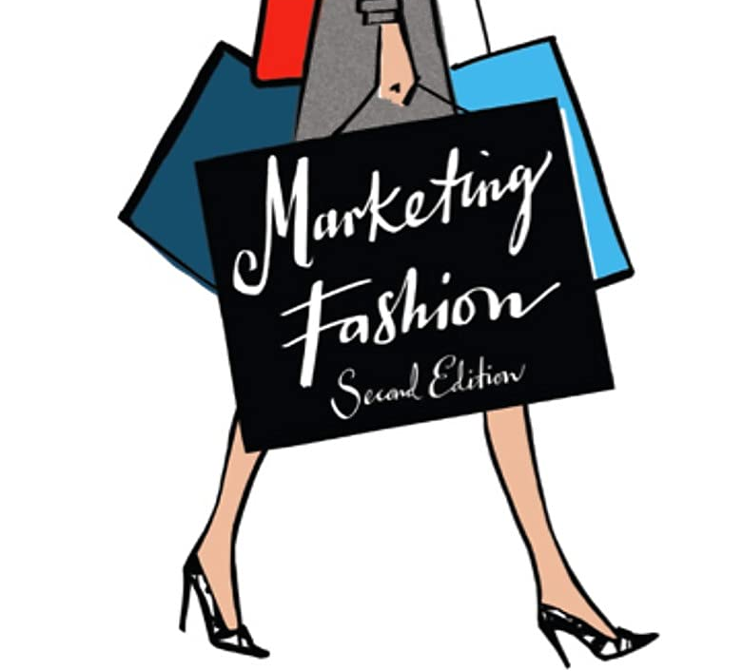



About Me
Notes:
….I am excited about graduating from the Data Analytics boot camp.

Slide 3
My Project - Objectives
What is the average Birth Year of people who respond to a marketing campaign?
How does the response rate differ across demographics?
How does the response differ across the number of purchases?
Average number of store purchases vs websites
What's the impact of this on response?

Slide 4
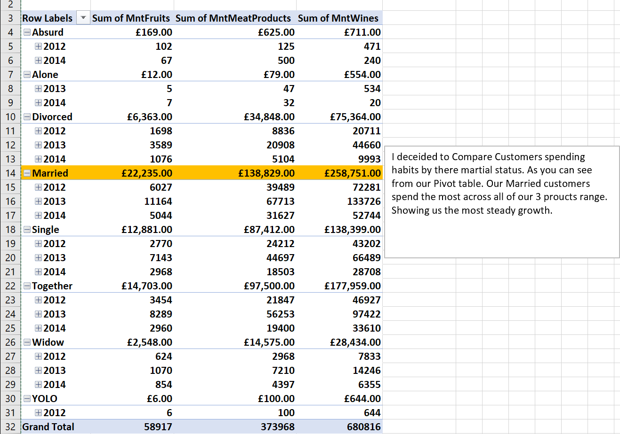
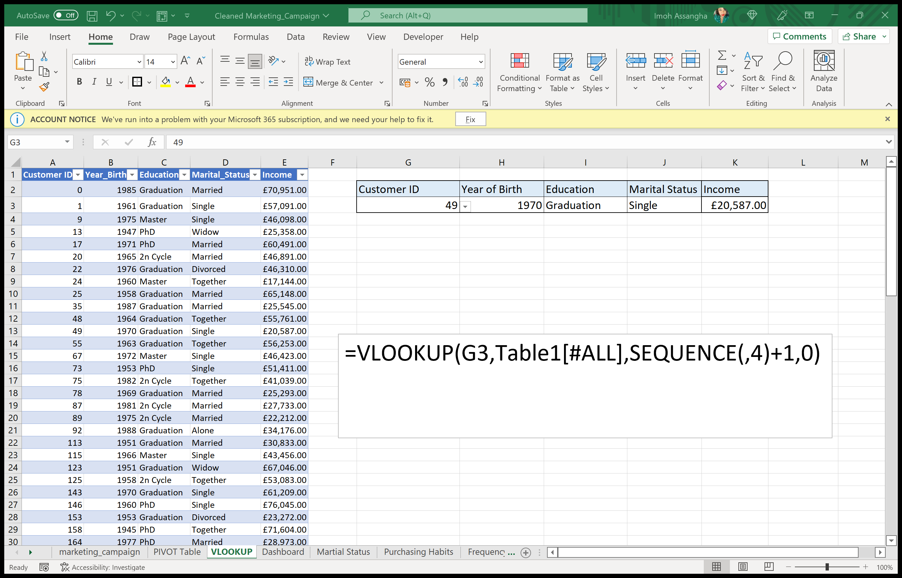
My Project - Excel Findings
Pivot table
VLOOKUP & SEQUENCE

Slide 5
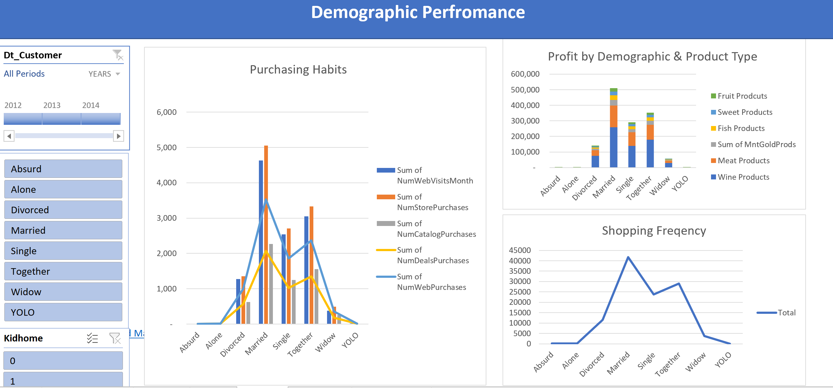
My Project - Excel Findings
Excel Dashboard

Slide 6
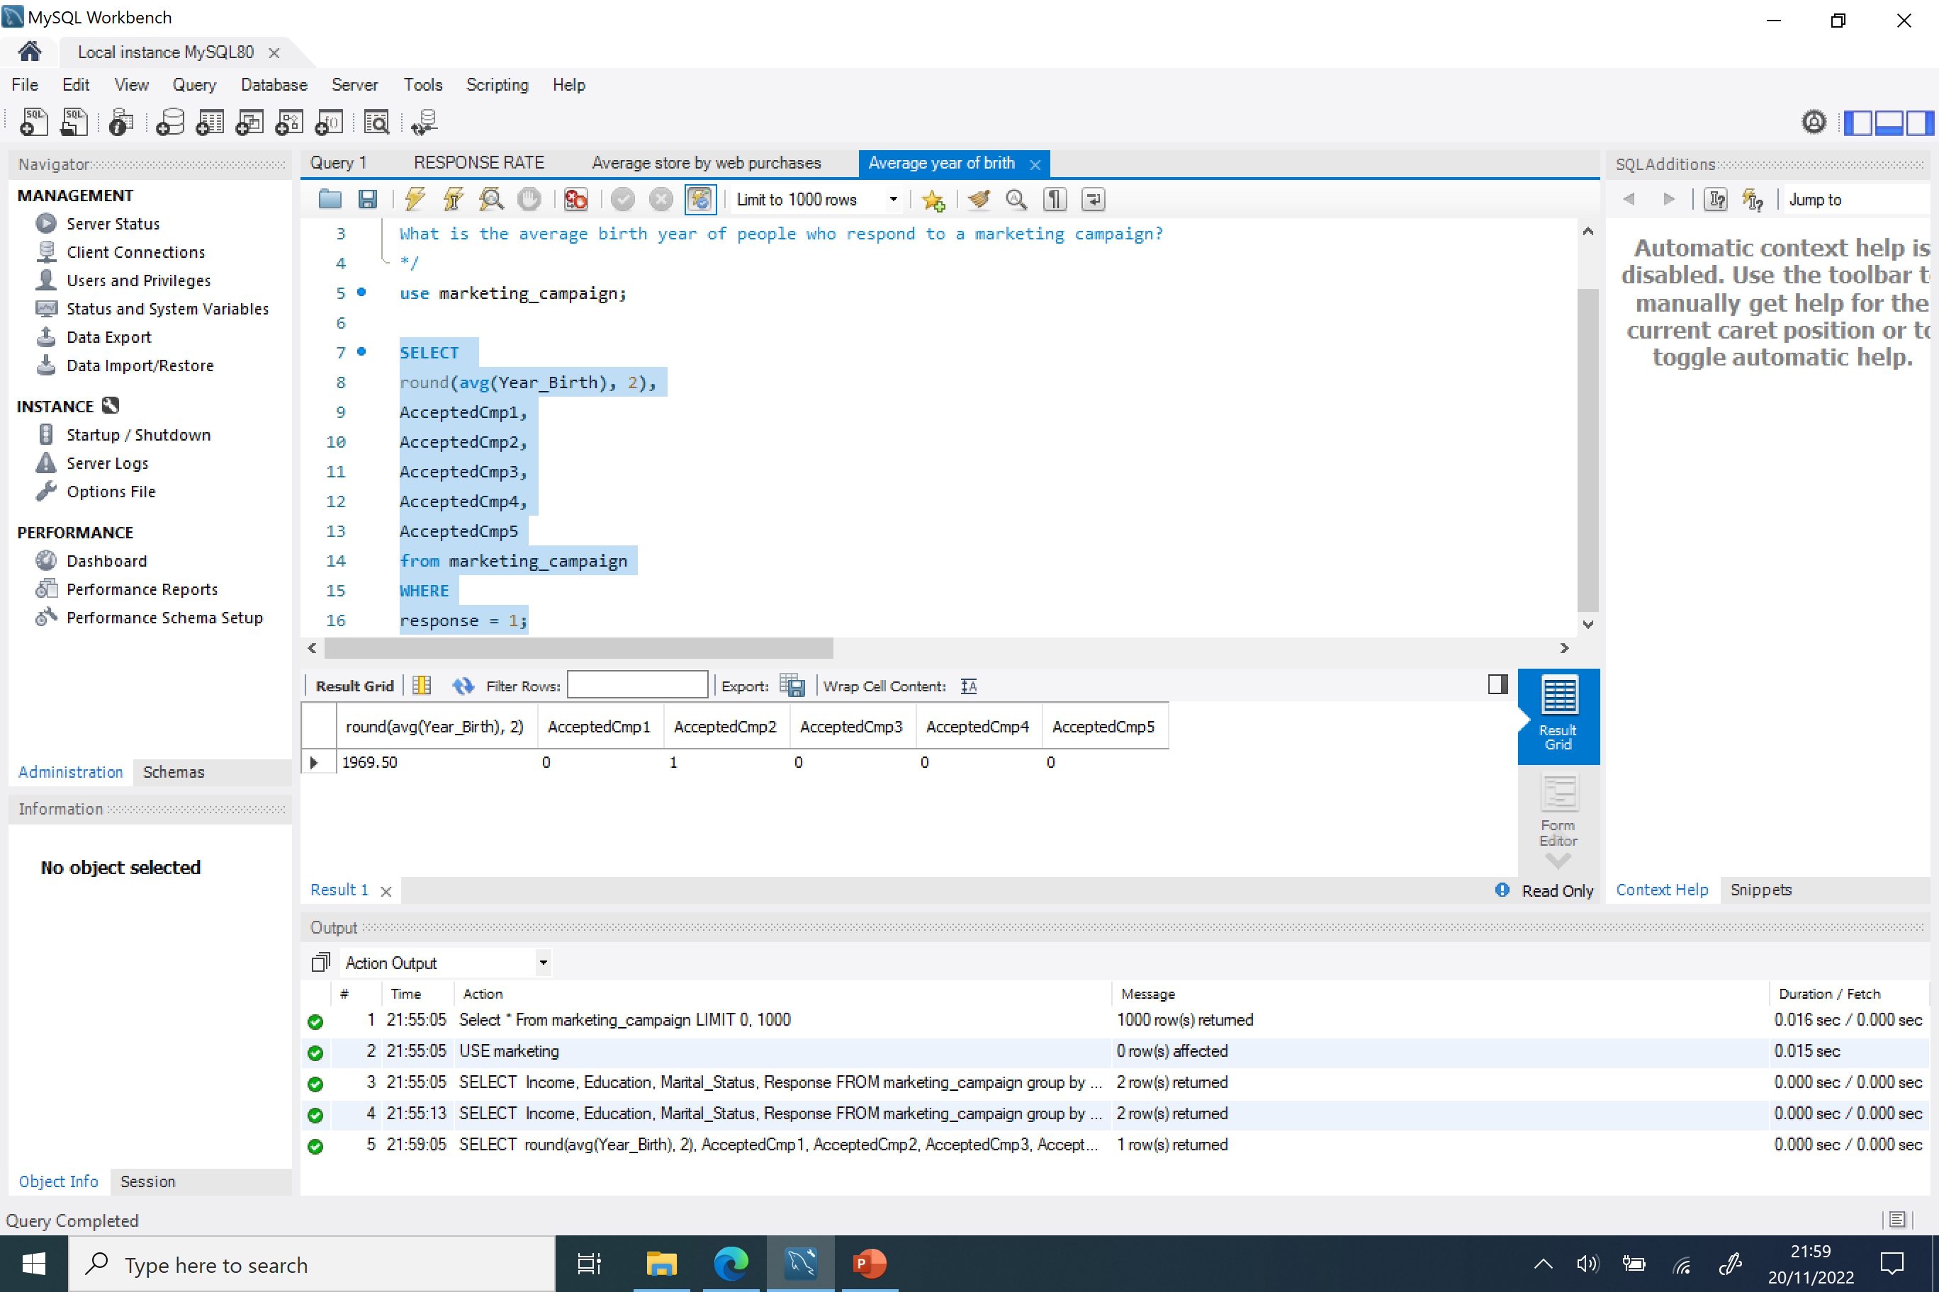
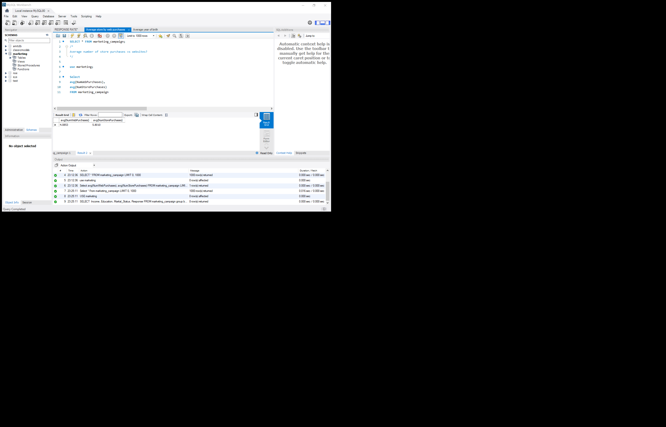
My Project - SQL Analysis
AVG
Where / = / Round & AVG

Slide 7
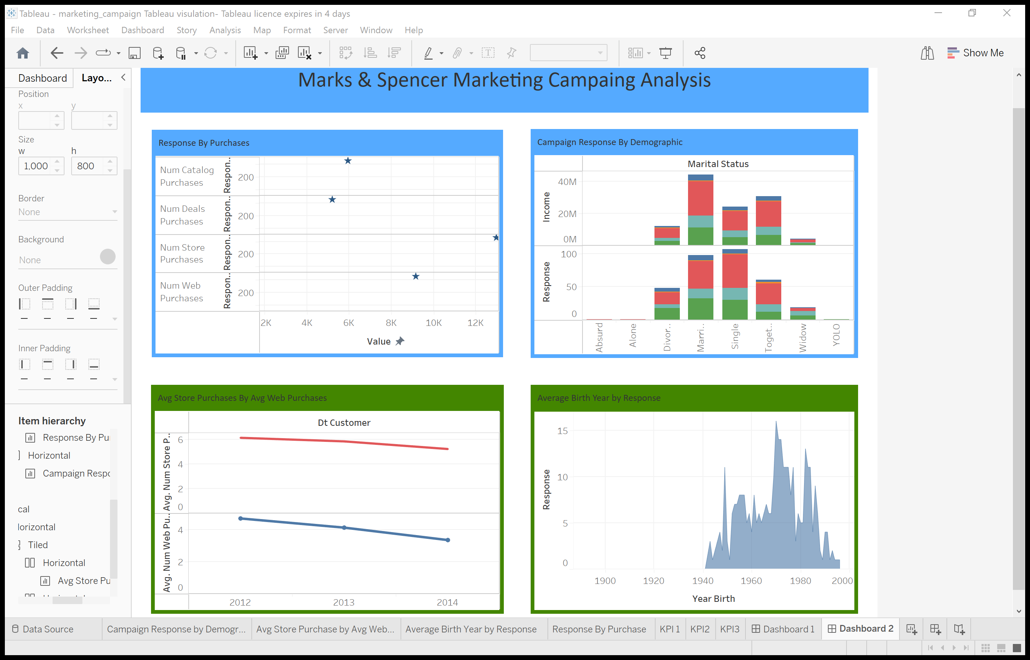
My Project - Dashboard

Slide 8



My Project - Recommendations/Insights
Insights
- Our key demographic is someone born in the 1969 -1970
Married
Educated to graduate level
Highest earning potential
Highest response rates to our campaigns
Highest response rates came from our stores.
Recommendations
- Target our core customer (married couples)
- Providing more discounts and incentives in store.
- To create a couple culture for our brand.
- New product line specifically for Married couples Focusing on meats & wines

Slide 9
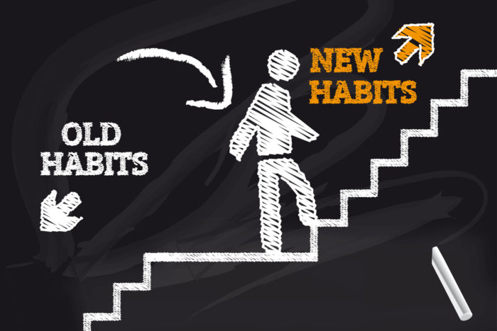

Challenges

Slide 10
Conclusion and Key Learnings
For me attending this bootcamp was a way for me to change my career and working in a more creative industry, earn more money and be apart of something that was more impactful and meaningful to peoples lives. Going forward I would like to work as a Marketing Analyst or a Data Analyst for a trend company like WGSN.
My top 3 key learnings: Educationally – That there is so much you can do Excel that I never gave that program credit for. Personally – You should never be the first person to say, No to yourself. Leave that to other people and then use that negativity as fuel to motivate yourself instead. Career-wise – Never stop learning or dreaming. Push, push, push!!!!!
If I could relate some of the principles I applied from the project management side of the course that really helped get through. It would be define project goals & objectives, create a strategy & monitor & measure progress.

